Slide 1
Switching Nandana Prabhu

Slide 2
Switching
Switching is a method by which multiple communication devices are connected to one another efficiently.
Switches are devices capable of creating temporary connections between two or more devices linked to the switch but not to each other.
It is a intermediate hardware or software that links devices together temporarily.

Slide 3
Switched Network

Slide 4
Switch
Switches are devices capable of creating temporary connections between two or more devices linked to the switch but not to each other.

Slide 5
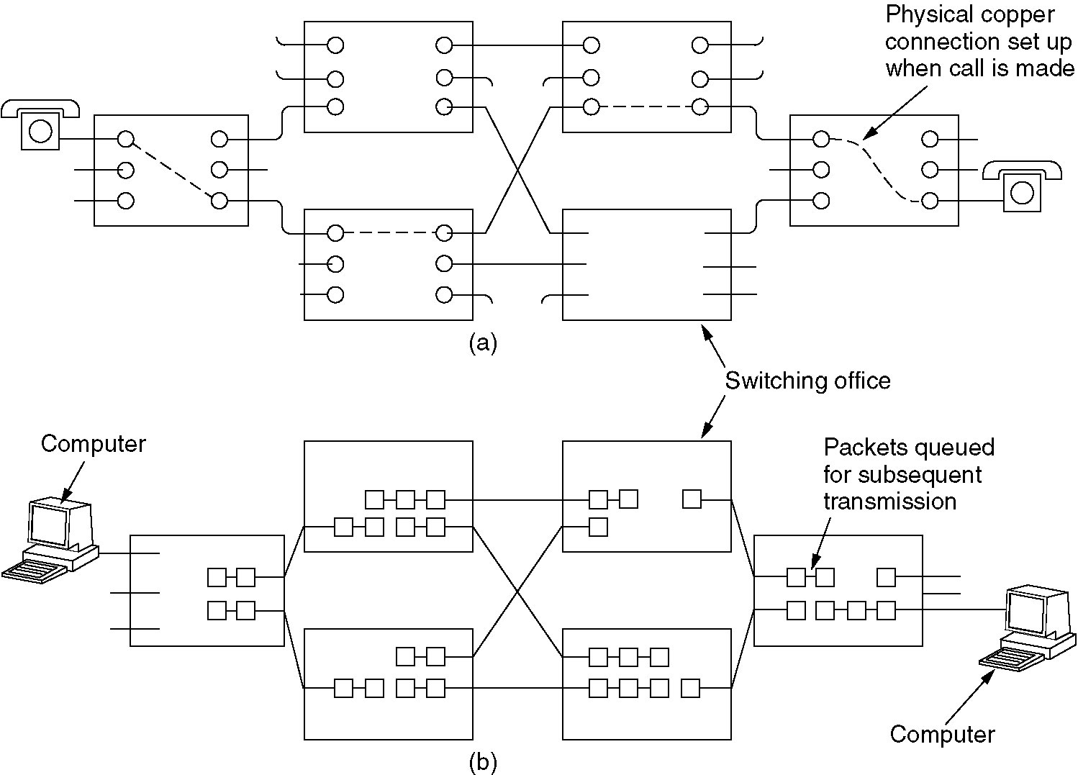
Circuit Switching
(a) Circuit switching.
(b) Packet switching.

Slide 7
Circuit-Switched Network

Slide 8
Circuit Switching
A circuit switch network is made up of a set of switches connected by physical links, in which each link is divided into n channels
There are three phases:
Set up phase
Data Transfer Phase
Terminate phase

Slide 9
Circuit Switching
The resources need to be reserved during the set up phase
The resources remain dedicated for the entire duration of data transfer
Until teardown
Application:
Telephone Networks

Slide 10
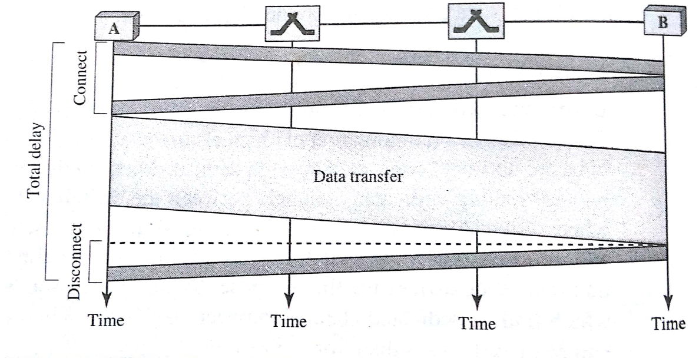
Circuit switching-Timing Diagram

Slide 11
Switch

Slide 13
Crossbar Switch

Slide 14
Multistage Switch

Slide 15
Time-Slot Interchange

Slide 16
TST Switch

Slide 18
Packet Switching
There is no resource reservation
Resources are allocated on demand

Slide 19
Datagram Networks
Referred to as connectionless networks.
Here the switch need not keep information of about connection table
No setup and tear down phase
Each packet is treated in same way regardless of its source and destination

Slide 20
Datagram Networks
Switch in a datagram network uses a routing table that is based on destination address
The destination address remains the same throughout the entire journey of packet.
Efficiency: more than circuit switch
Delay : greater

Slide 21
Datagram Approach

Slide 22
Datagram Approach, Multiple Channels

Slide 23
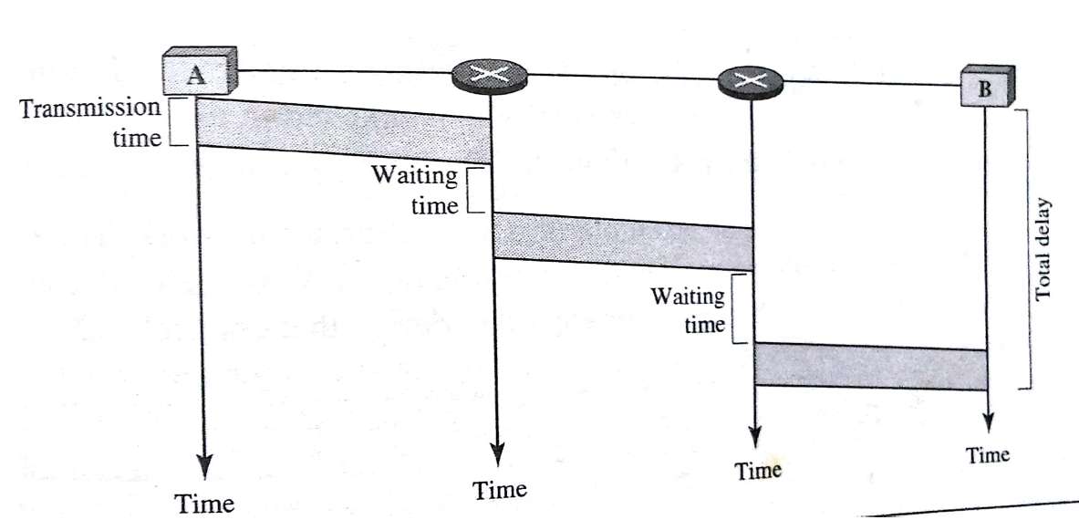
Packet switching-Timing Diagram

Slide 24
Switched Virtual Circuit
As in circuit switching it has setup phase, data transfer phase and terminate phase
Resources are allocated during setup or on demand as in datagram
As in datagram , each packet carries an address , but address is localised

Slide 25
Switched Virtual Circuit

Slide 26
Switched Virtual Circuit

Slide 27
Switched Virtual Circuit

Slide 28
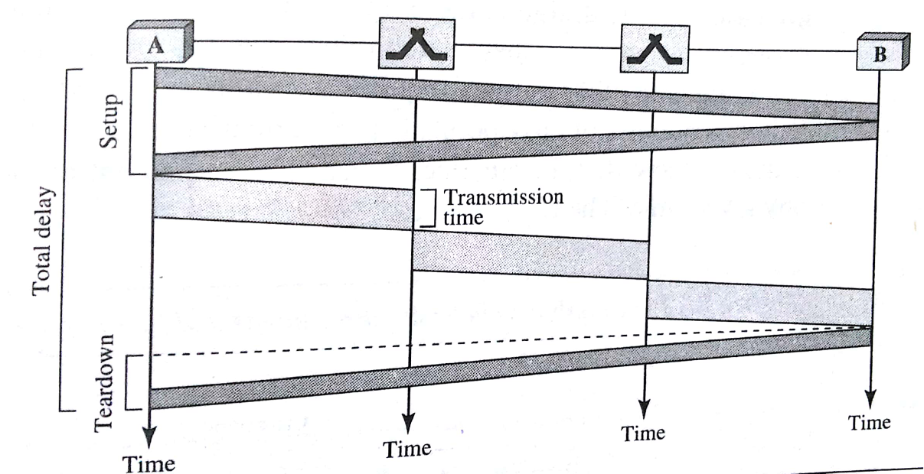
Virtual circuit switching_Timing Diagram

Slide 29
Switching
Circuit switching- physical layer
Virtual circuit- Data link layer
Datagram- Network layer

Slide 30
Message Switching

Slide 31
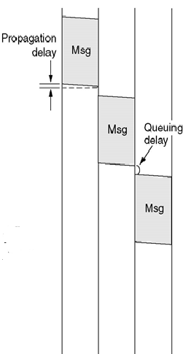
Message switching-Timing Diagram

Slide 32
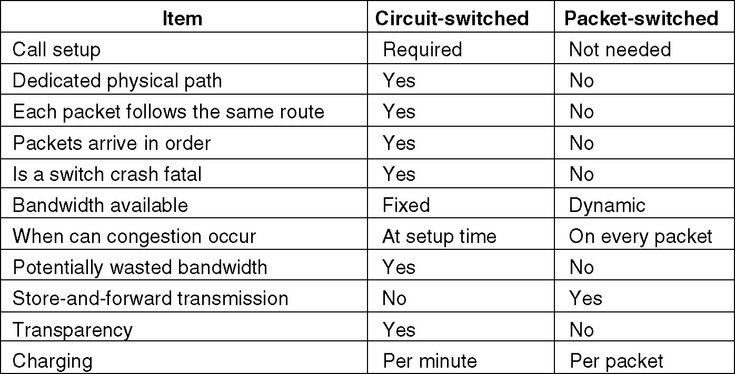
Circuit switched v/s Packet Switching

Slide 33
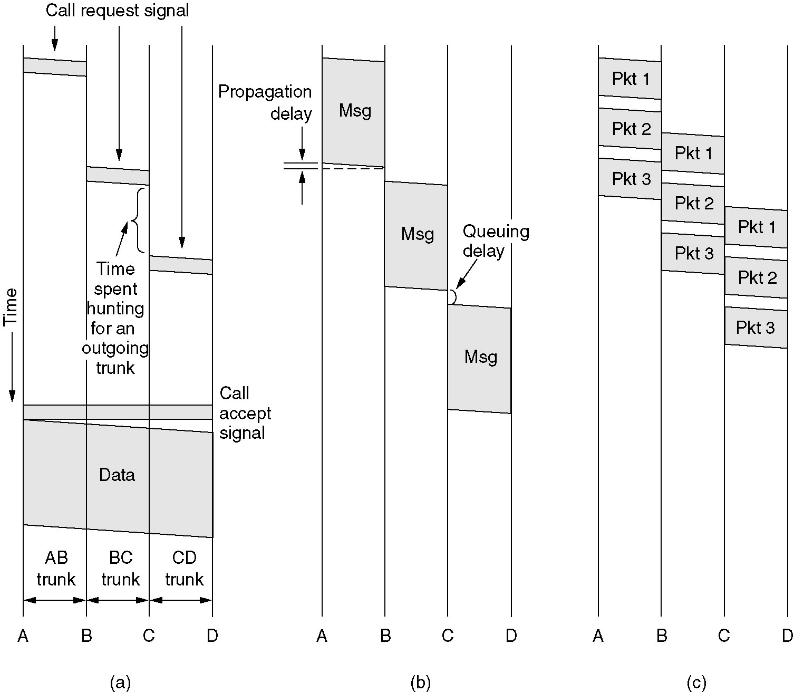
Message Switching
(a) Circuit switching (b) Message switching (c) Packet switching

Slide 34
In circuit switching, timing diagram, the last phase i.e. Terminate phase is not shown(frm D to A)

